Slide 1


Aetheris VTE
A local, private AI coding agent, powered by VTE. Your own AMD Native AI Ecossystem!

Slide 2

Every AI coding assistant sends your code somewhere else. Aetheris doesn't.

Slide 3

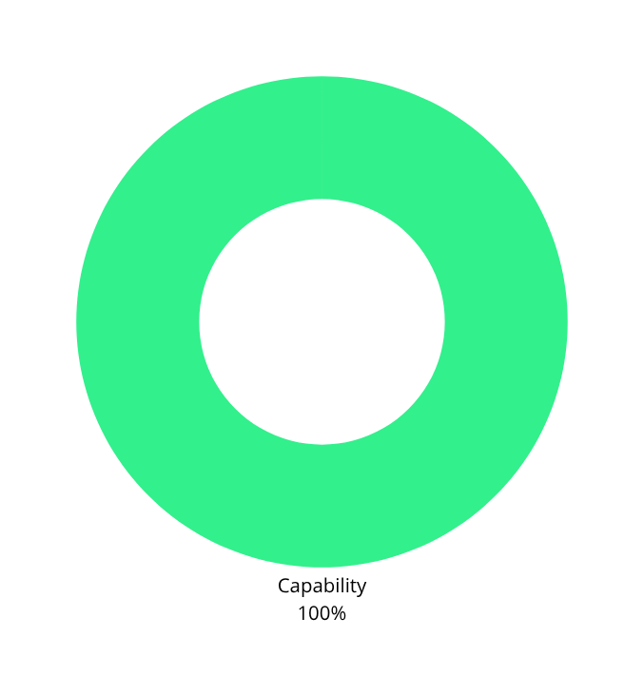
Tool Invocation
(Bash, file read/write/delete, git, codebase search, web search)
Multi-step planning
(Hard server-side toggle between Planner and Builder modes)
5
Local multi-turn memory
(Durable across sessions, independent of chat transcript)
Local knowledge retrieval (RAG)
(Zero-overhead TF-IDF Skill Library, no secondary neural embedding model required)
Permission control & privacy
(Local auth gate, human-in-the-loop explicit approval for destructive writes/shell execution or web-read tool)

Slide 4
Flutter UI
(Desktop App)
Python Backend
(FastAPI, LocalPipe)
Agent Loop
(Tool dispatch & RAG)
VTE Engine
(Custom HIP Kernels,
Inference engine
from scratch)
AMD GPU
(Bare-metal
execution)
The engine pre-allocates persistent activation buffers for every intermediate tensor up front, capturing the decode path into a HIP Graph to eliminate Python-side dispatch overhead.

Slide 5
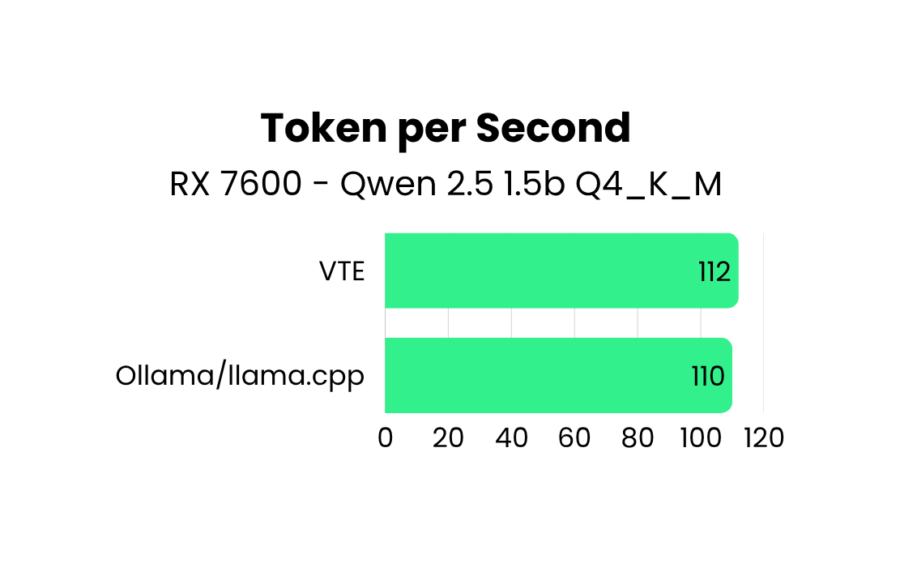
We didn't use Ollama or Llama.cpp
We built our own AMD Native inference engine form scratch

Slide 6

Hardware Vitals
Radeon PRO W7900 Cloud Instance
(96 CUs, 48Gb). Running the massive Granite 4.1 30B (Q8_O) and Llama 3.1 70B Q4_K_M.
Peak Temp: 55C
Zero thermal throttling across back-to-back generations.
Peak Power: 243W
Sustained perfectly against the 241W TDP limit.

Slide 7
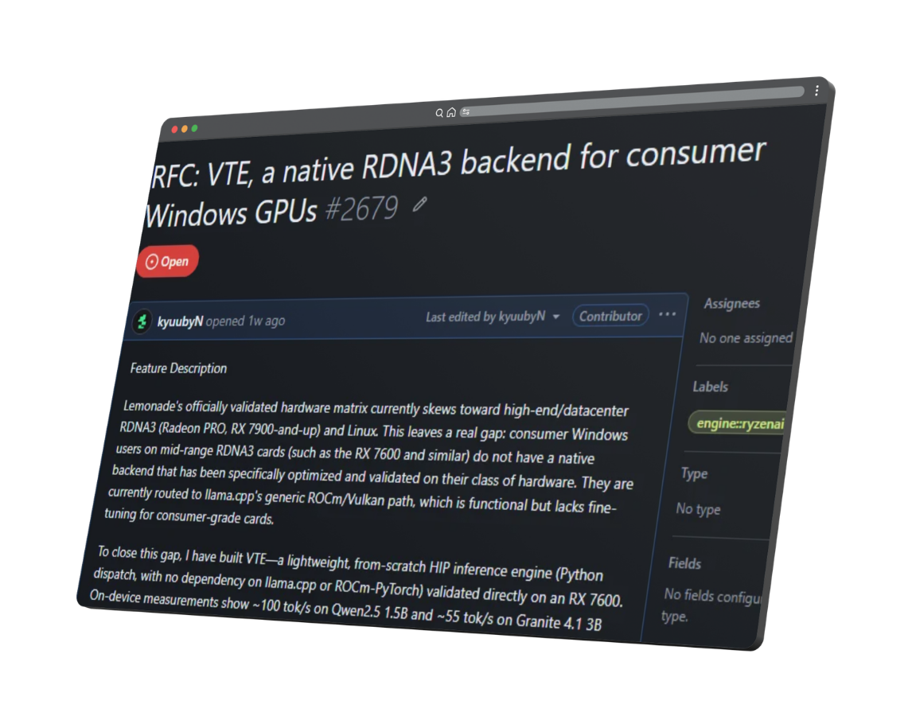

Impact beyond the hackathon
VTE is currently in review as an official experimental backend for AMD Lemonade local LLM server.
Credited by name in Lemonade's official v11.5.0 release notes.
Directly upstreamed the RX 7600 hardware detection fixes.

Slide 8
Aetheris VTE.
Your own AMD Native ecossystem
by: Kaue Oliveira Costa (kyuubyN)
With love, from Brazil

